Slide 1

Modeling with Linear Functions
Applications of Linear Equations

Slide 2
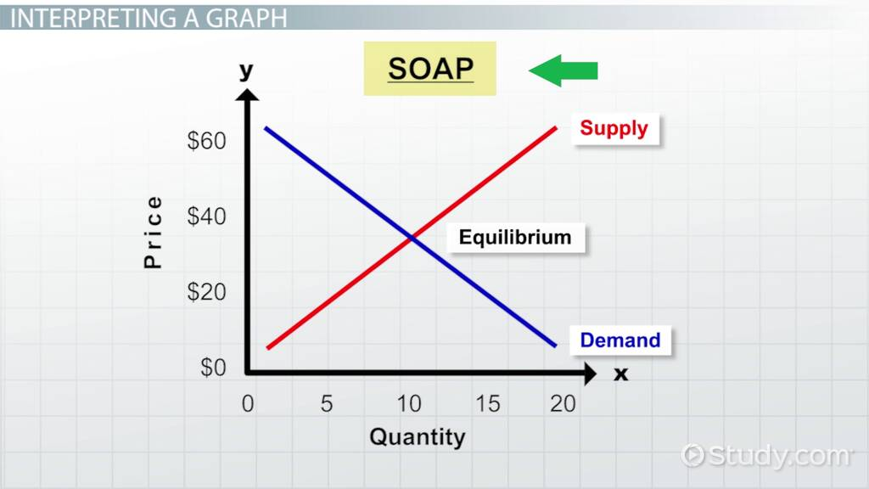
Supply and Demand
Higher price means less demand with oversupply
Lower price means greater demand with not enough supply

Slide 3
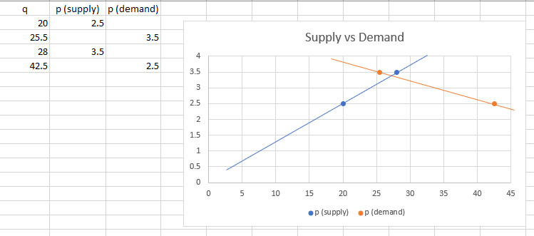
Example: Graphing Supply/Demand from data
Demand (q) in thousands | Supply (q) in thousands | Output (price)
42.5 | 20 | 2.50
25.5 | 28 | 3.50

Slide 4
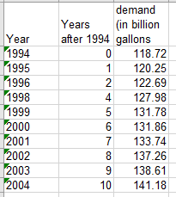
Regression – Extrapolation & Interpolation
Open a blank Excel sheet and enter the following data

Slide 5
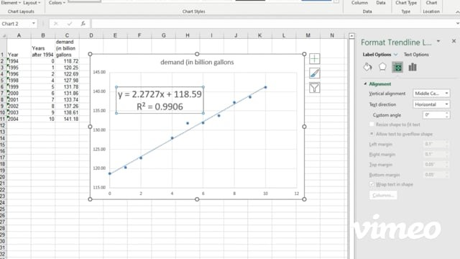
The Regression Line – Graph and Equation

Slide 6

Interpolation: Finding missing data
Our dataset is missing the year 1997
How many years after 1994 is that? (This is x)
Use the equation found from our data/regression to calculate demand
Y=2.2727x + 118.59

Slide 7

Extrapolation: Predicting Future Data
Can we use this model to predict the gasoline demand in 2008?
What about 2005?
Let’s do both… what would x be?
Use the equation y = 2.2727x + 118.59

Slide 8
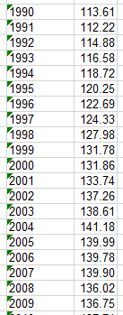
How far off were we?
Subtract the actual (observed) value minus your predicted value (expected)
This is the “error” (we call the error data “residuals”)
What can you conclude about the efficacy of the model that was based only on partial data?

Slide 9
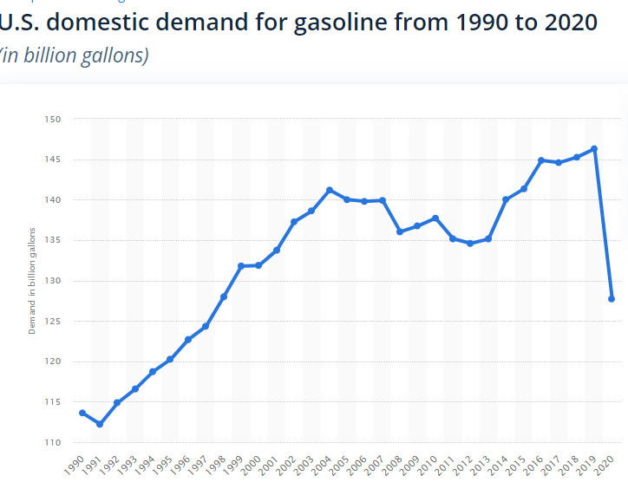
Gasoline Demand in the U.S.
Does the data support a “linear model” in the years 1990 to 2004? Discuss why or why not. What about beyond 2004 to the present time? Discuss why or why not.

